Slide 1
Just One More Ministry Tracking Software

Slide 2
Overview of System
Tracks food categories and weights
Incoming & Outgoing
View Reports
Look up Organization Information

Slide 3
Testing User Data Entry
Manual Data Entry
Time
Smart Widget
Time
Voice Commands
Time
# of Commands
SUS

Slide 4
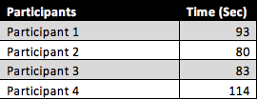

Manual Data Entry Results

Slide 5


Smart Widget (Two New Organizations)

Slide 6
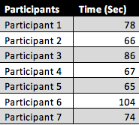

Smart Widget (No New Organizations)

Slide 7

Smart Widget (No New Orgs) vs No Widget
Student’s t Test
Null Hypothesis: Widget Time = No Widget Time
Alternative Hypothesis: Widget Time < No Widget Time

Slide 8
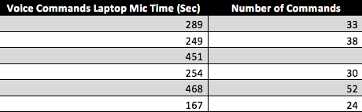
Voice Command Data Entry Laptop Mic
Optimal Number of Commands = 22

Slide 9
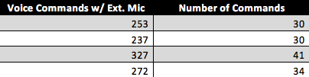
Voice Commands Data Entry External Mic
Optimal Number of Commands = 22

Slide 10
External Mic Time vs Laptop Mic Time
Null Hypothesis: External Mic Time = Laptop Mic Time
Alternative Hypothesis: External Mic Time < Laptop Mic Time
t statistic = 6.614
P value = .000084

Slide 11
External Mic Commands vs Laptop Mic Commands
Null Hypothesis: External Mic Commands= Laptop Mic Commands
Alternative Hypothesis: External Mic Commands> Laptop Mic Commands
t statistic = .8555
P value = .21

Slide 12
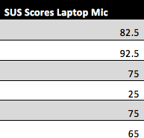

SUS For Voice Command Data Entry Laptop Mic

Slide 13
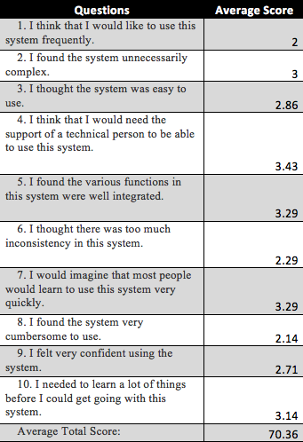
SUS Questions Average w/ Laptop Mic

Slide 14
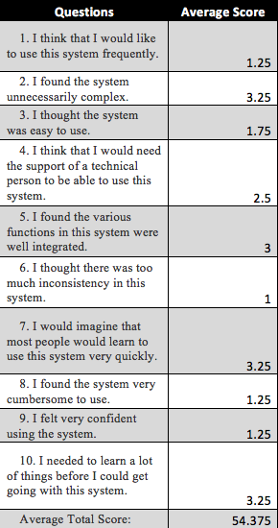
SUS Questions Average w/ External Mic

Slide 15
Both SUS Scores

Slide 16
Discussion
Widget increases efficiency, if the widget can predict organizations
Laptop Mic takes more time to enter data than External Mic
SUS scores show that people would rather not use voice commands
SUS scores show that people find the voice commands easy to use

